Slide 1
Logic
DR. ADEEl HASHMI
Asst. prof., Cse dept
Msit, janakpuri

Slide 2
Proposition
A proposition is a declarative sentence (i.e. a sentence that declares a fact) that is either true or false at a time.
Delhi is the capital of India.
Sydney is the capital of Australia.
2+6=10
2+2=5
“What time is it?” is not a proposition.

Slide 3
Propositional Logic
The propositional logic consists of logical operators to perform operations on propositions. These logical operations are:
Negation (denotes the opposite of the current sentence)
Disjunction (eq. to “or” of english language)
Conjunction (eq. to “and” of english language)
Implication (eq. to “if-then” of english language, only left to right associativity)
Bi-implication (eq. to “if-then” of english language, with associativity in both directions)

Slide 4
Symbols
In symbolic logic, these operations are represented by:
~ (negation)
￢ (negation)
⋁ (disjunction i.e. OR)
⋀ (conjunction i.e. AND)
→ (implication)
↔ (bi-implication)

Slide 5
Compound Propositions
The propositions formed by combining two or more propositions are called compound propositions
e.g “Today is Sunday and a holiday” which consists of two propositions “Today is Sunday” and “Today is a holiday” connected by “and”.

Slide 6
Symbolic Logic
In symbolic form, we assign a propositional/logic variable to each sentence (just like we use variable like x/y in mathematics to represent a value) to make the representation easier.
For example, the compound proposition
“Today is Sunday and a holiday”,
can be represented in symbolic form as
p∧q where
“p: Today is Sunday” and “q: Today is a holiday”.

Slide 7
Implication vs Bi-implication
Let’s try to understand the difference between implication and bi-implication by an example. The statement “If today is sunday then today is holiday” is true, but the reverse case “If today is holiday then today is sunday” is not always True, so it is a case of implication.
However, the statement “If today is sunday then tomorrow is monday” is always true when reversed i.e. “If tomorrow is monday then today is sunday”, so it is a case of bi-implication”.

Slide 8
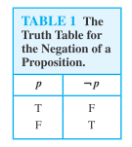
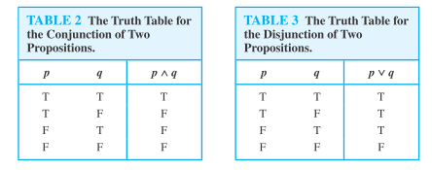
Truth Tables (1)

Slide 9
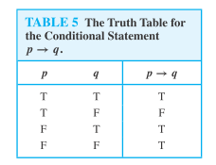
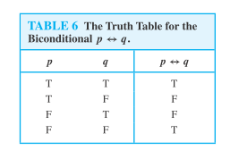
Truth Tables (2)

Slide 10
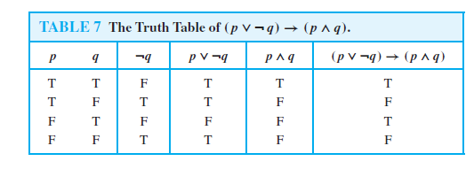
Question
Construct truth table for (p ⋁ ￢ q) → (p ⋀ q)

Slide 11
Implication
The statement p→q can be read as
p implies q
if p then q (sometimes written as “if p, q”)
p only if q
p is sufficient for q
q is necessary for p
q if p
q when p
q whenever p
q follows from p
q unless ￢p

Slide 12
Bi-implication
The statement p↔q can be read as
p if and only if q (sometimes written as “p iff q”)
if p then q, and conversely
p is necessary and sufficient for q

Slide 13
Question-1
Let P be “It is snowing”, let Q be “I will go to town” and R be “I have time”. Write the following statements in English:
i. Q↔(R⋀￢P)
ii. ￢(R⋀Q)
Answer
i. I will go to town if and only if I have time and it is not snowing.
ii. It is not true that I have time and will go to town.

Slide 14
Question-2
Write in symbolic form “It is freezing but not snowing”.
Answer.
f : It is freezing
s : It is snowing
f ⋀ ￢s

Slide 15
Question-3
Let p be “Erik reads Newsweek”, let q be “Erik reads the New Yorker”, and let r be “Erik reads Time”. Write each of the following in symbolic form:
i. Erik reads Newsweek and The New Yorker, or he does not read Newsweek and Time.
ii. It is not true that Erik reads Time or The New Yorker but not Newsweek.
Answer.
i. (p⋀q)⋁￢(p⋀r)
ii. ￢[(r⋁q)⋀￢p]

Slide 16
Question-4
Express the statement “The automated reply cannot be sent when the file system is full” in symbolic form.
Answer.
r: The automated reply can be sent.
f: The file system is full
As the sentence makes use of “when” so we need to swap the position of statements.
f → ￢r

Slide 17
Converse Inverse
For every conditional statement (p→q), we can write its converse, inverse and contrapositive.
q → p (converse)
￢p → ￢q (inverse)
￢q → ￢p (contrapositive)

Slide 18
Question
Write converse inverse and contrapositive for the statement “If John is a poet then he is poor”.
Answer
Converse: If John is poor then he is a poet.
Inverse: If John is not a poet then he is not poor.
Contrapositive: If John is not poor ten he is not poet.

Slide 19
Tautology / Contradiction
A compound proposition that is always true, irrespective of the truth values of the propositions in it, is called a tautology e.g. p ⋁ ￢ p .
A compound proposition that is always false irrespective of the truth values of the propositions in it, is called a contradiction e.g. p ⋀ ￢ p .
A compound proposition that is neither a tautology nor a contradiction, is called a contingency.

Slide 20
Logical Equivalence
Two compound propositions are said to be logically equivalent if they have identical truth tables.
The notation p≡q denotes that p and q are logically equivalent.
p→q ≡ ￢p⋁q

Slide 21
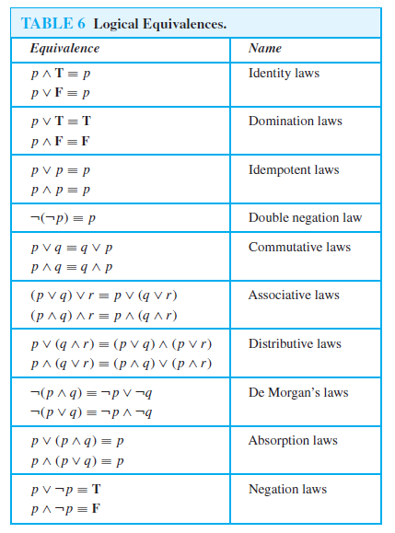

Slide 22
Normal Forms
Conjunctive Normal Form (CNF): conjunctions of disjunctions e.g. (a⋁b)⋀(c⋁d)
Disjunctive Normal Form (DNF): disjunctions of conjunctions e.g. (a⋀b)⋁(c⋀d)
Steps
(i) Remove implication: p→q ≡ ￢p⋁q
(ii) Move negation inwards by DeMorgan’s law
(iii) Apply distributive law.

Slide 23
Question
Example-3.10.
Obtain CNF and DNF for p⋀(p→q).
Answer.
p⋀(p→q) ≡ p⋀(¬p⋁q) ……………………… CNF
p⋀(¬p⋁q) ≡ (p⋀¬p)⋁(p⋀q) ………………. DNF

Slide 24
Canonical Forms
Canonical Form is an extension of normal form where each term contains all variables in either complemented or uncomplemented form.
A disjunctive term containing literals of all variables is called as maxterm.
A conjunctive term containing literals of all variables is called as minterm.
PDNF (Principal Disjunctive Normal Form): disjunctions of minterms
PCNF (Principal Conjunctive Normal Form): conjunctions of maxterms

Slide 25
Question
Example-3.14.
Obtain PCNF and PDNF of ¬(p⋀q).
Answer.
¬(p⋀q) ≡ (¬p⋁¬q) …………………… PCNF
(¬p⋁¬q) ≡ (¬p⋀T)⋁(¬q⋀T) ≡
[¬p⋀(q⋁¬q)] ⋁ [¬q⋀(p⋁¬p)] ≡
(¬p⋀q)⋁(¬p⋀¬q)⋁(¬q⋀p)⋁(¬q⋀¬p) ………… PDNF

Slide 26
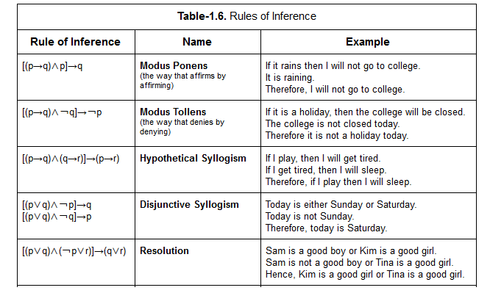
Rules of Inference

Slide 27
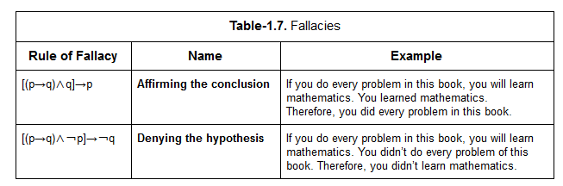
Fallacies

Slide 28
Question-1
Example
Test the validity of the following argument.
If two sides of a triangle are equal then the opposite angles are equal.
The opposite angles are not equal.
Therefore, two sides of a triangle are not equal.
Answer.
Let p: two sides of a triangle are equal, q: the opposite angles are equal.
The given conclusion is of the form [(p→q)⋀￢q]→￢p] i.e. modus tollens.
Hence, the given conclusion is correct according to law of modus tollens.

Slide 29
Question-2
Example
Determine whether the following arguments are valid or invalid.
Premises:
If I read the newspaper in the kitchen, my glasses would be on the kitchen table.
I did not read the newspaper in the kitchen.
Conclusion: My glasses are not on the kitchen table.
Answer.
Let, p: I read the newspaper in the kitchen, q: my glasses would be on the kitchen table.
The given conclusion is of the form [(p→q)⋀￢p]→￢q.
This is the fallacy of denying the hypothesis. Hence, the given conclusion is incorrect.

Slide 30
Question-3
Example
Prove the validity of the following argument. “If I get a job and work hard then I will get promoted. If I get promoted then I will be happy. I am not happy. Therefore, either I did not get the job or I did not work hard”.
Answer.
j: I get a job
w: work hard
p: I will get promoted.
h: I will be happy/i am happy.
The given premises can be written as: ([j⋀w]→p), (p→h), ￢h.
Applying hypothetical syllogism on ([j⋀w]→p)⋀(p→h), we get ([j⋀w]→h).
Applying modus tollens on ([j⋀w]→h)⋀￢h, we get ￢[j⋀w] ≡ ￢j⋁￢w.
So, the conclusion is “I did not get the job or I did not work hard”.

Slide 31
Predicate Logic
Predicate logic is more powerful type of logic, and is an extension of propositional logic.
Predicate logic helps us to reason with general statements like “All men are mortal”, whereas propositional logic can only deal with specific statements like “John is intelligent”.

Slide 32
Proposition vs Predicate
In propositional logic, we represent whole sentence by a logic variable.
In predicate logic, we identify the subject and the predicate in the sentence and represent the sentence as predicate(subject).
e.g. “John is intelligent” will be represented as
intelligent(John)

Slide 33
Operators
Predicate Logic utilizes all the operators of propositional logic.
In addition, it has two more operators called as quantifiers.
universal quantifier ∀ read as “for all”.
existential quantifier ∃ read as “there exists”.
A quantifier is generally associated with a predicate variable which is used as a generic subject.
e.g. ∀xP(x) representing that P is true for all x.

Slide 34
Examples
All men are mortal.
∀x: man(x) → mortal(x)
Some men are intelligent.
∃x: man(x) ⋀ intelligent(x)

Slide 35
Question
Example
Let the Universe be integers and let N(x) denote “x is a non-negative integer”, E(x) denote “x is even”, O(x) denote “x is odd” and P(x) denote “x is prime integer”. Translate the following statements into symbolic form:
(i) All prime integers are non-negative.
(ii) If a non-negative integer is not odd then it’s even.
Answer.
(i) ∀x: P(x)→N(x)
(ii) ∀x: [N(x)⋀￢O(x)] → E(x)

Slide 36
Question
Example
Express the following statements in symbolic form
Every student in this class has visited Taj Mahal
Some students in this class have visited Paris.
Answer.
∀x: S(x)→TM(x)
∃x: S(x)⋀P(x)
Note that ∃x(S(x)→P(x)) is incorrect, as it violates the property of implication, because some students have visited Paris and some have not visited Paris.

Slide 37
Question
Example
Write the following sentences in symbolic form:
All friends are good.
At least one friend is good.
Not everyone is perfect.
No one is perfect.
Not everybody is a friend or someone is not good.
Nothing is in the correct place or in good condition.
There exists a criminal who has done every crime.
Answer.
∀x:friend(x)→good(x)
∃x:friend(x)⋀good(x)
￢[∀x: perfect(x)] OR ∃x: ￢perfect(x)
￢[∃x:perfect(x)] OR ∀x: ￢perfect(x)
￢∀x:friend(x) ⋁ ∃y:￢good(y)
￢∃x:correct_place(x)⋁good_condition(x) OR ∀x:￢[correct_place(x)⋁good_condition(x)]
∃x∀y: criminal(x) ⋀ crime(y) OR ∃x: criminal(x) ⋀ ∀y: crime(y)

Slide 38
Question
Example-3.24.
Represent the statement using predicate logic and negate it
“For all the real number x if x>5 then x²>25”.
Answer.
∀x: (x>5)→(x²>25)
We have to negate the statement, so first we remove the implication
∀x: (x≤5)⋁(x²>25)
Now, we negate it
∃x: (x>5)⋀(x²≤25)
As, we are negating a logically correct statement, therefore the negation is not logically correct.

Slide 39
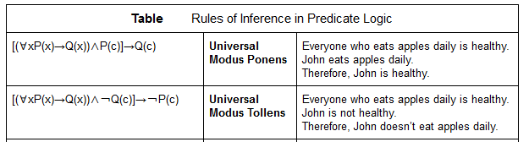
Inference

Slide 40
Question
Example-3.31.
Determine whether the following arguments are valid or valid.
Premises:
The metro cities of India have huge traffic.
Delhi has huge traffic.
Conclusion: Delhi is an Indian metro city.
Answer.
[∀x: metro(x)→huge_traffic(x)] ⋀ huge_traffic(Delhi) →
metro(Delhi)
This is fallacy of Affirming the Conclusion.
Hence, the conclusion is incorrect.

Slide 41
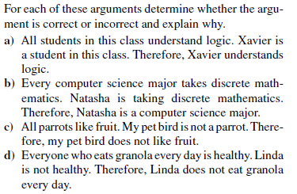
Questions

Slide 42

EXERCISE-1

Slide 43
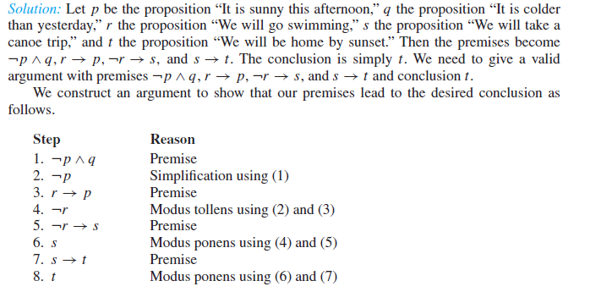
Solution

Slide 44

EXERCISE-2

Slide 45
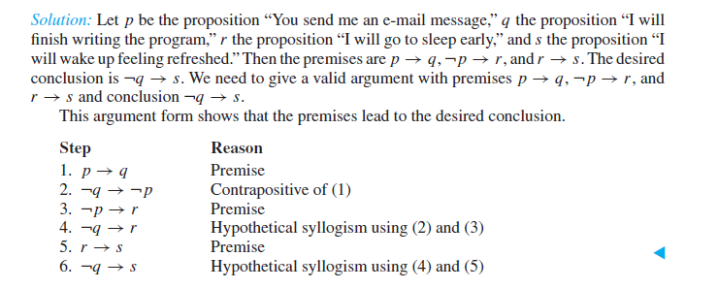
Solution

